Slide 1
Statistical Inferences In Business
Jamaal Smith
Module 3 Project
Flatiron School

Slide 2
Table Of Contents
Executive Summary
Situation 1: Does discount amount have a significant effect on the quantity of a product in an order?
Situation 2: Does a shipment’s final destination impact the length of time it takes for it to get delivered?
Situation 3: Does a shipment’s final ship region have an impact on its freight cost?
Situation 4: Does an employee’s date of birth affect their hire date?

Slide 3
Executive Summary
Statistical inferences are useful for business planning. For Northwind, a business that delivers its goods to its customers by shipping them, examining whether a shipment’s destination affects the length of its transit time is a worthwhile pursuit. Longer shipment times to certain regions may represent market opportunities for further growth that will require additional research.
Along this same vein of analysis, we can also examine whether certain regions have a higher average freight cost per shipment. Findings from this analysis will help determine whether all regions order roughly the same amount of goods and identify regions that order at a higher rate than others.
Additionally, hypothesis testing can assist with the firm’s strategy around offering discounts on products. Not only can we determine whether more products are sold when a discount is offered. We can determine the levels of discount drive product sells the most.
Finally, hypothesis testing can help us determine whether certain attributes about the firm’s employees can be used as predictors, or more specifically, allow us to create a general profile of employees at the Northwind organization.

Slide 4
Does Discount affect Amount of Product ordered?
Situation 1

Slide 5
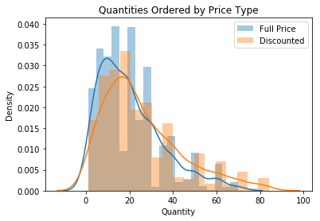
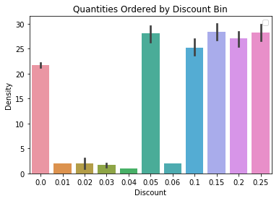
Product Discount and Quantity Ordered
With a p-score 0.0, we were able to reject the null hypothesis that stated a product’s discount has no impact on the quantity of product ordered.
Further analysis highlighted that discounts of 5%, 15%, 20% and 25% resulted in the most gains in quantity of products ordered.
Request for further analysis: Further analysis can be conducted to determine what discount level is appropriate for a product based on its life-cycle.
By this, is a 25% discount most advantageous when a product is first brought to market or when trying to make room for new inventory?

Slide 6
Does a Shipment’s Destination Affect its length of time in Transit?
Situation 2

Slide 7
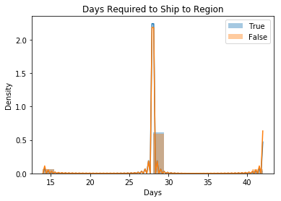
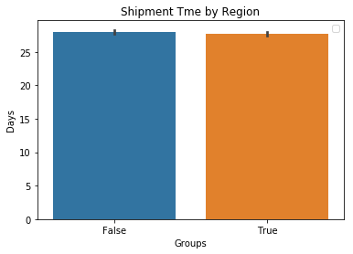
Shipment region and Shipment time
With a p-score of 0.42, we were not able to reject the null hypothesis that stated a product’s shipment region had no affect on its shipment time.
For the purposes of this analysis, one group of shipment regions contained all regions in the Americas and Europe. This group is represented, for ease of analysis, as True. All other regions are labeled as False.
As the graphical representation of the data suggests, shipments have an average time of delivery equal to roughly 28 days regardless of region.

Slide 8
Does a Shipment’s final destination affect its Freight cost?
Situation 3

Slide 9
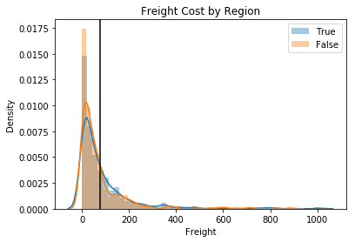
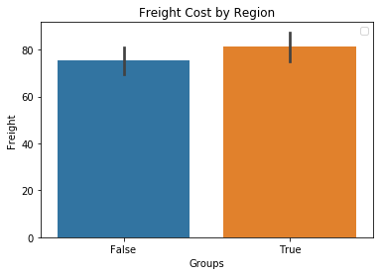
Shipment region anD Freight Cost
With a p-score of 0.003, we are able to reject the null hypothesis that stated a product’s freight cost will remain the same regardless of shipment region.
As the bottom-left graph depicts, the effect size of shipment region is rather small with a Cohen’s D of .21 calculated
For the purposes of this analysis, one group of shipment regions contained all regions in the Americas and Europe. This group is represented, for ease of analysis, as True. All other regions are labeled as False.
In further analysis, it will be worthwhile to examine whether the higher freight costs in markets located in the Americas and Europe are due to higher units per order or whether freight costs are higher in these markets than those located in Asia and Africa.
This vein of analysis will be especially valuable should the company learn that freight costs are inherently lower outside Americas/Europe market and units per order are not widely disparate. This could represent a market opportunity that could be profitable with the assistance of marketing and other inroads.

Slide 10
Does an Employees Date of Birth Help Determine Their Date of Hire?
Siutation 4

Slide 11
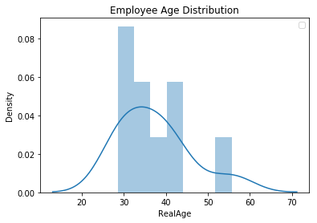
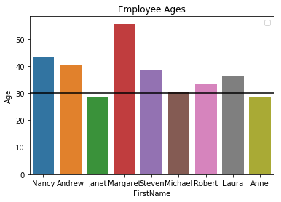
Employee Date of Birth and Date of hire
With a p-score of 0.01, we are able to reject the null hypothesis that the average age of employees is 30 years of age.
While the average age of employees is not 30 years of age. However, graphical representation of the data shows that a major proportion of employees are in the 30-40 year old age range.
With a sample of only 9 employees, not much can be garnered from this analysis. However, it is important to note how the age of Margaret impacts this analysis drastically.

